Slide 1
INTRO TO DATA SCIENCE
LECTURE 1
general assembly

Slide 2

AGENDA
Producer introduction
Instructor introduction
Student introductions
Course logistics
Project
VCS, GIT, Github
Computer setup
What is Data Science?
data science

Slide 3

INSTRUCTOR INTRODUCTION
MICHAEL GALVIN
Data Scientist, GE
galvin.mj@gmail.com
@MikeJGalvin
linkedin.com/in/MikeJGalvin
data science

Slide 4
STUDENT INTRODUCTIONS
Your name
A brief summary of your background (work, school, etc.)
What do you hope to get out of this class
data science

Slide 5
COURSE EXPECTATIONS:
BE PRESENT
PARTICIPATE
GET TO KNOW EACH OTHER
ASK QUESTIONS
data science

Slide 6
COURSE LOGISTICS
Syllabus
Course data and time
Course Expectations
Schedule
Office hours
Slack for communication
Homework
Course Project
Github
data science

Slide 7


title
what is data science?
data science

Slide 8
WHAT IS DATA SCIENCE?
No Formal Definition
data science

Slide 9
WHAT IS DATA SCIENCE?
No Formal Definition
data science

Slide 10
WHAT IS DATA SCIENCE?
No Formal Definition
A set of tools and techniques used to extract useful information from data
data science

Slide 11
WHAT IS DATA SCIENCE?
No Formal Definition
A set of tools and techniques used to extract useful information from data
An interdisciplinary, problem-oriented subject.
data science

Slide 12
WHAT IS DATA SCIENCE?
No Formal Definition
A set of tools and techniques used to extract useful information from data
An interdisciplinary, problem-oriented subject
The application of scientific techniques to practical problems
data science

Slide 13
WHAT IS DATA SCIENCE?
No Formal Definition
A set of tools and techniques used to extract useful information from data
An interdisciplinary, problem-oriented subject.
The application of scientific techniques to practical problems.
Analyzes raw data to make impactful decisions
data science

Slide 14
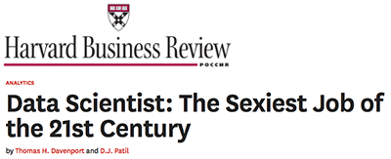
WHAT IS DATA SCIENCE?
No Formal Definition
A set of tools and techniques used to extract useful information from data
An interdisciplinary, problem-oriented subject.
The application of scientific techniques to practical problems.
Analyzes raw data to make impactful decisions
A rapidly growing field.
data science

Slide 15

QUALITIES OF A DATA SCIENTIST?
data science

Slide 16
QUALITIES OF A DATA SCIENTIST?
Programming Languages
Hadoop
Databases
Spark
Map-Reduce
Statistical Computing eg. R
Statistics
Machine Learning
Optimization
Probability
Linear Algebra
Business Understanding
Influence
Strategy
data science

Slide 17
QUALITIES OF A DATA SCIENTIST?
Programming Languages
Hadoop
Databases
Spark
Map-Reduce
Statistical Computing eg. R
Statistics
Machine Learning
Optimization
Probability
Linear Algebra
A FEW MORE THINGS!
Visualization
Change Management
Communication
Business Understanding
Influence
Strategy
Collaboration
data science
Notes:
10 minutes

Slide 18
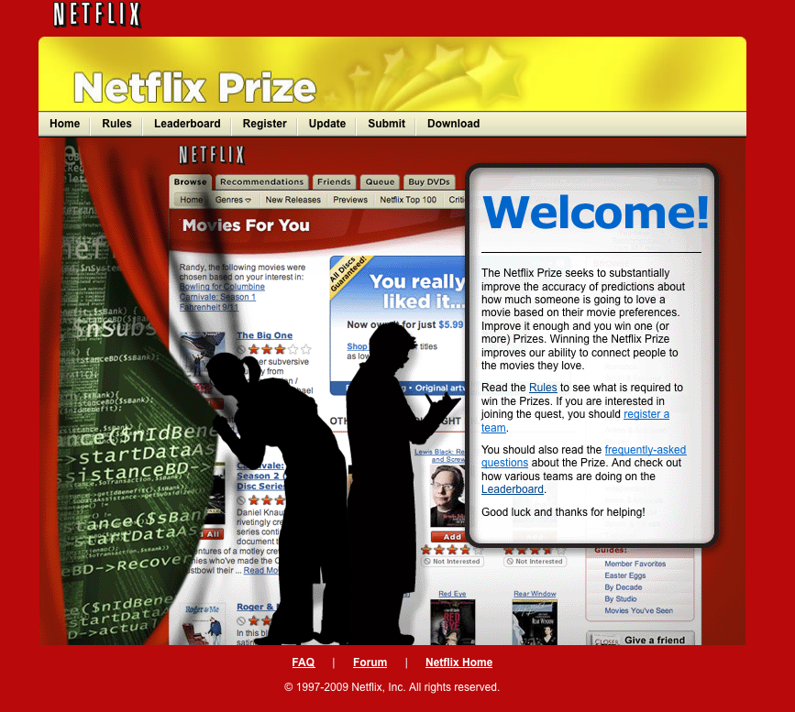
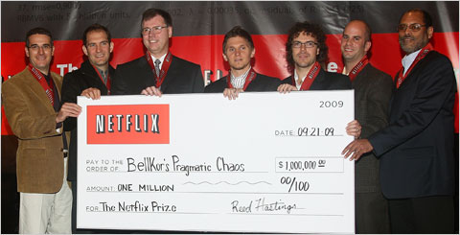
WHO USES DATA SCIENCE?
Develop best movie rating prediction
$50k Progress prize yearly until
winner
$1,000,000 prize to winner (10% improvement)
Started: October 2, 2006
Ended: June 26, 2009
data science

Slide 19

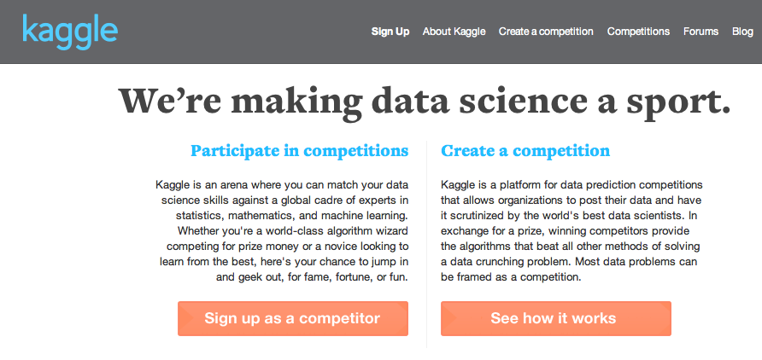



WHO USES DATA SCIENCE?
data science

Slide 20
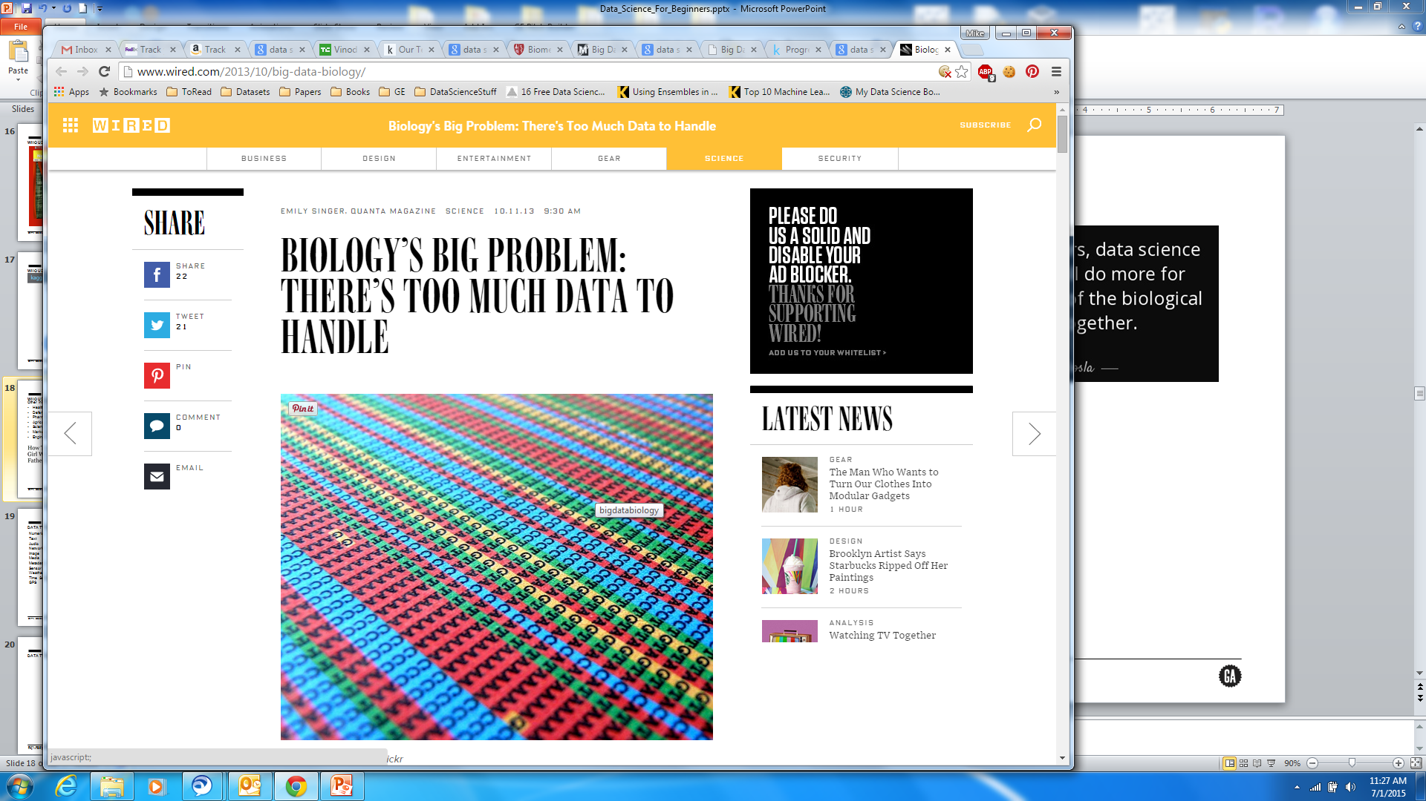
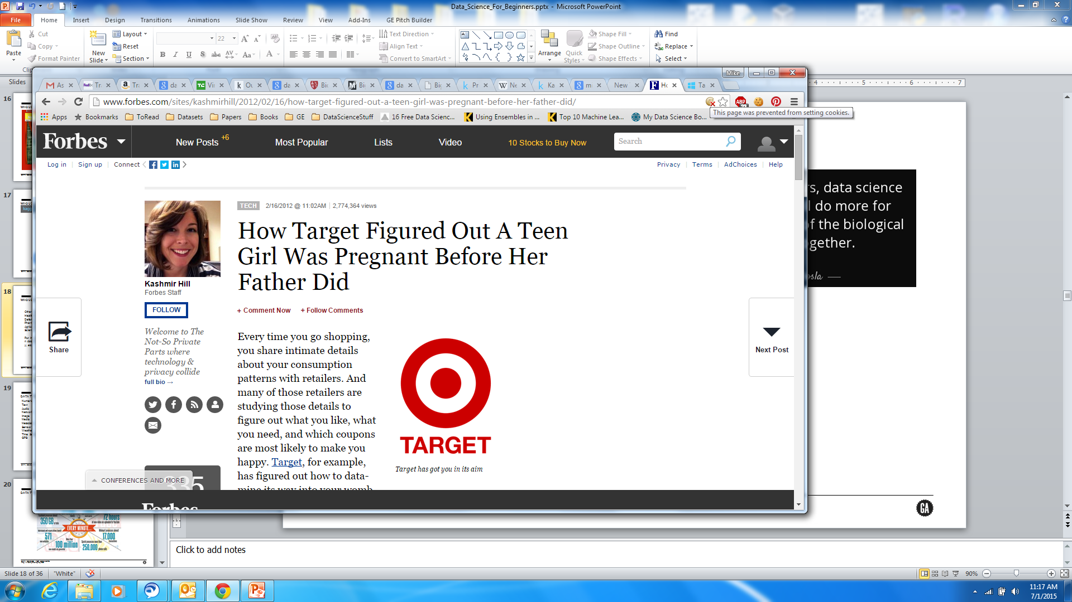
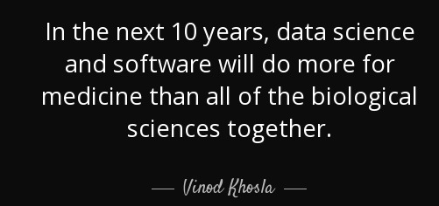
WHO USES DATA SCIENCE?
Other interesting applications:
Healthcare
Defense
Pharmaceuticals
Agriculture
Science
Marketing
Engineering
data science

Slide 21
HOW DOES GE USE DATA SCIENCE?
Operations
Engineering
Monitoring and Diagnostics
Risk
Marketing
IoT
data science
Notes:
25 minutes

Slide 22
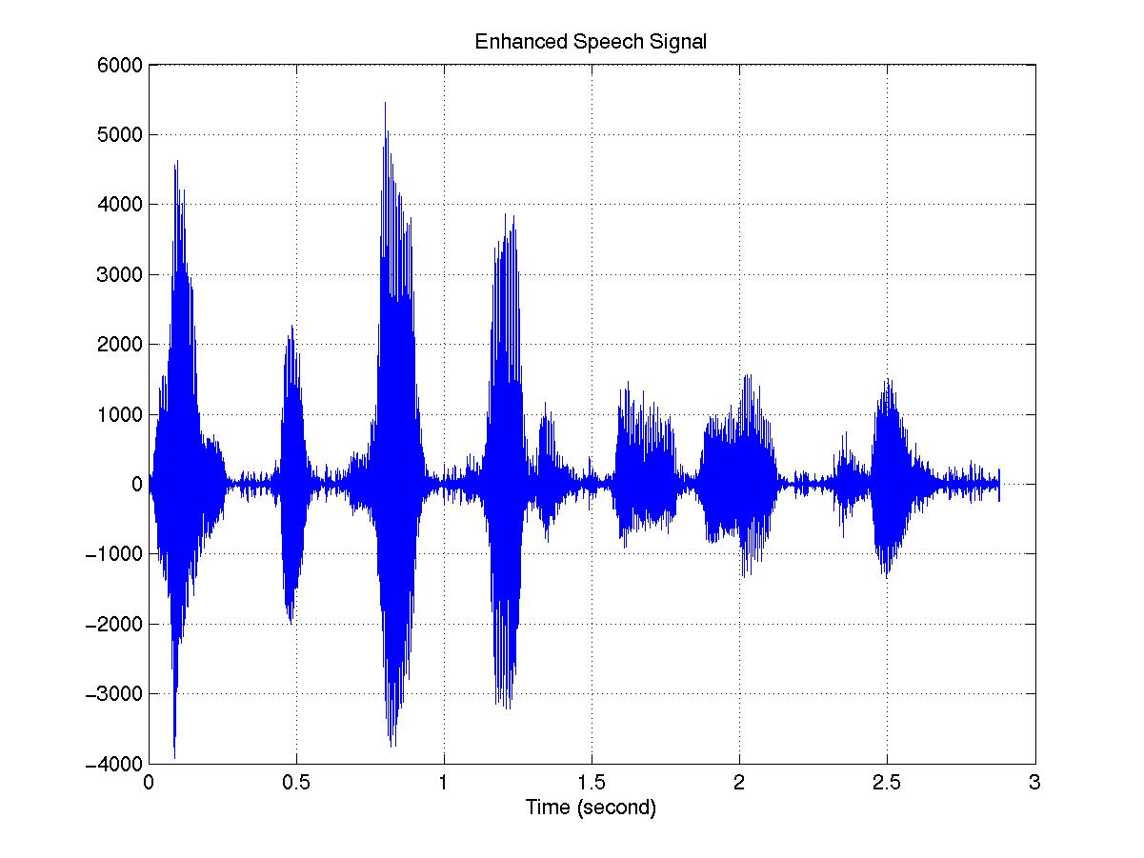
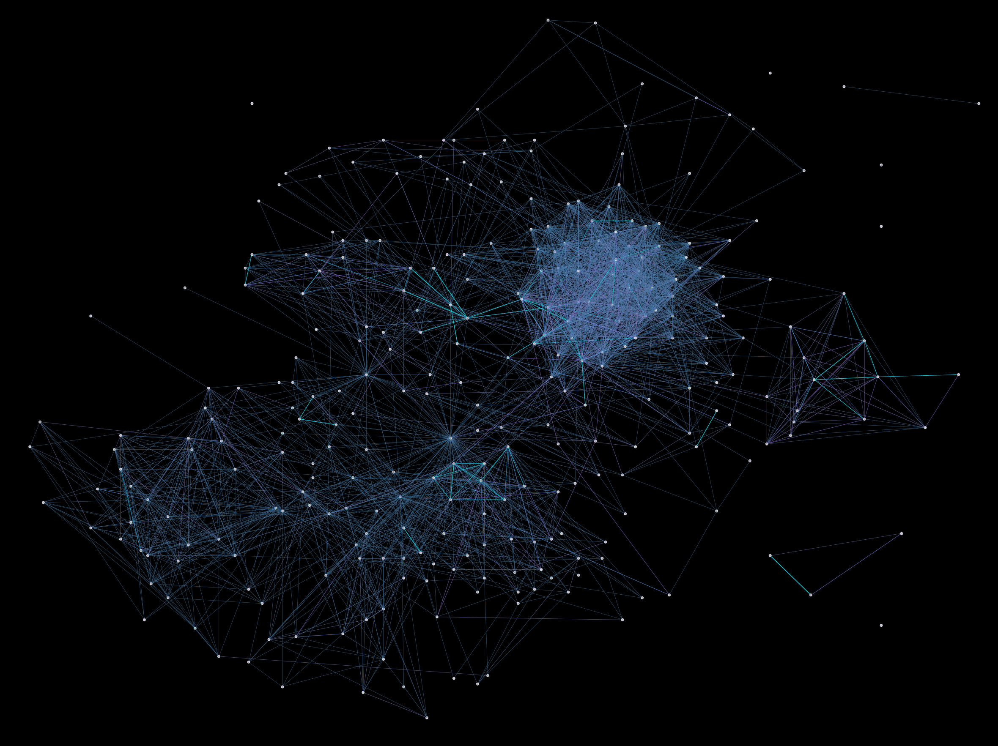
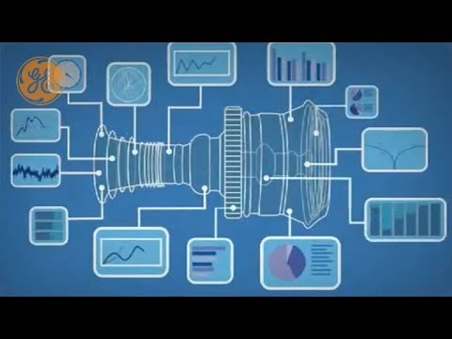
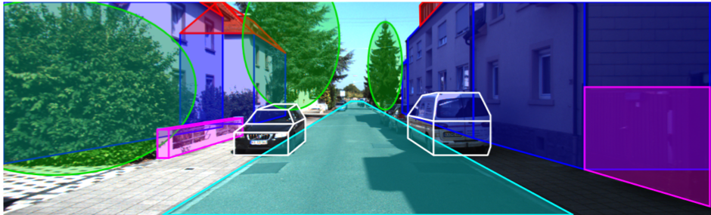
DATA TYPES
Numeric
Text
Audio
Network
Image
Media
Metadata
Sensor
Weather
Time Series
GPS
data science

Slide 23
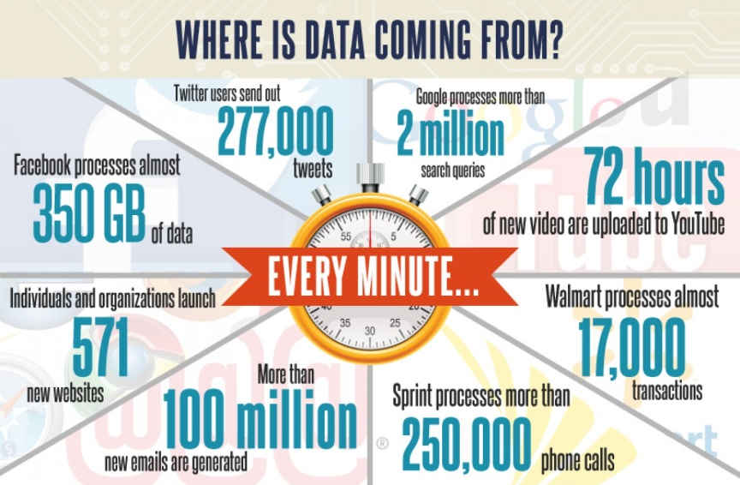
DATA TYPES?
data science
http://visual.ly/how-big-big-data

Slide 24
DATA TYPES?
Data Science <> Big Data
data science
http://visual.ly/how-big-big-data

Slide 25
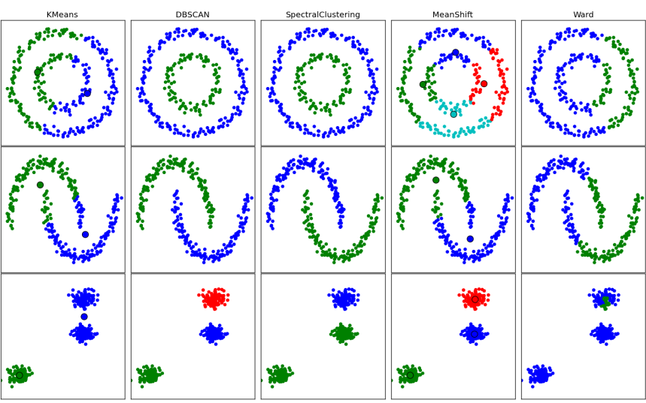
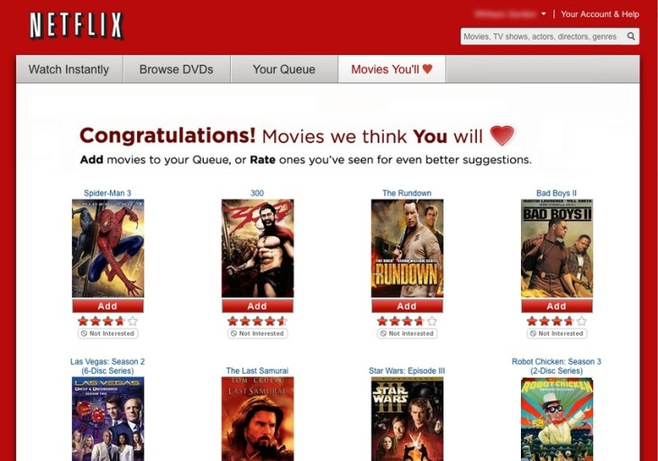
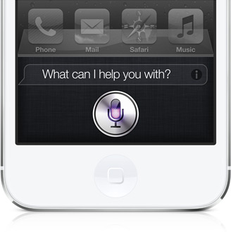
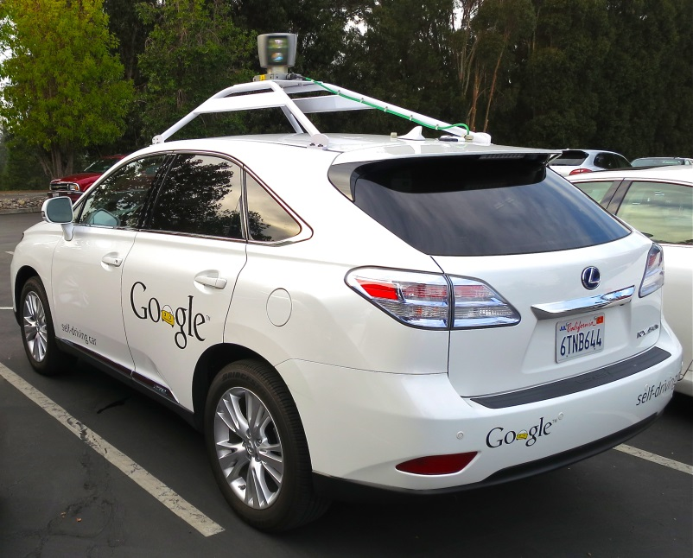
PROBLEM TYPES
Recommendations System
Associations
Relationships
Structure
Predictions
Forecasting
Optimization
Vision
Speech
Audio
data science

Slide 26

title
Data Science workflow
data science

Slide 27
DATA SCIENCE WORKFLOW
Business Understanding
Clean & Integrate Data
Analysis (explore, model, etc.)
Validate & Test
Extract & Understand Data
Visualize, Present
Operationalize
data science

Slide 28
What question are you trying to answer?
DATA SCIENCE WORKFLOW
Business Understanding
Clean & Integrate Data
Analysis (explore, model, etc.)
Validate & Test
Extract & Understand Data
Visualize, Present
Operationalize
data science

Slide 29
DATA SCIENCE WORKFLOW
Business Understanding
Clean & Integrate Data
Analysis (explore, model, etc.)
Validate & Test
Extract & Understand Data
Visualize, Present
Operationalize
Where is the data coming from? How is it generated?
data science

Slide 30
DATA SCIENCE WORKFLOW
Business Understanding
Clean & Integrate Data
Analysis (explore, model, etc.)
Validate & Test
Extract & Understand Data
Visualize, Present
Operationalize
How to connect data sources
together? Are there data quality
issues (missing values, wrong
type, etc.)
data science

Slide 31
DATA SCIENCE WORKFLOW
Business Understanding
Clean & Integrate Data
Analysis (explore, model, etc.)
Validate & Test
Extract & Understand Data
Visualize, Present
Operationalize
What are the important
features? What algorithms
do I use?
data science

Slide 32
DATA SCIENCE WORKFLOW
Business Understanding
Clean & Integrate Data
Analysis (explore, model, etc.)
Validate & Test
Extract & Understand Data
Visualize, Present
Operationalize
What are the important
features? What algorithms
do I use?
Danger: More isn’t always
better. Correlation doesn’t
equal causation.
data science

Slide 33
DATA SCIENCE WORKFLOW
Business Understanding
Clean & Integrate Data
Analysis (explore, model, etc.)
Validate & Test
Extract & Understand Data
Visualize, Present
Operationalize
Did I answer the question?
How well?
Appropriate training, validation, and testing
data science

Slide 34
DATA SCIENCE WORKFLOW
Business Understanding
Clean & Integrate Data
Analysis (explore, model, etc.)
Validate & Test
Extract & Understand Data
Visualize, Present
Operationalize
Did I answer the question?
How well?
Appropriate training, validation, and testing
Danger: Metrics can be deceiving.
data science

Slide 35
DATA SCIENCE WORKFLOW
Business Understanding
Clean & Integrate Data
Analysis (explore, model, etc.)
Validate & Test
Extract & Understand Data
Visualize, Present
Operationalize
Tell the story
data science

Slide 36
DATA SCIENCE WORKFLOW
Business Understanding
Clean & Integrate Data
Analysis (explore, model, etc.)
Validate & Test
Extract & Understand Data
Visualize, Present
Operationalize
How do I make this impactful?
data science

Slide 37
DATA SCIENCE WORKFLOW
Business Understanding
Clean & Integrate Data
Analysis (explore, model, etc.)
Validate & Test
Extract & Understand Data
Visualize, Present
Operationalize
Make this connection early
data science

Slide 38
title
DISCUSSION
q&a
data sciencE

